Slide 1
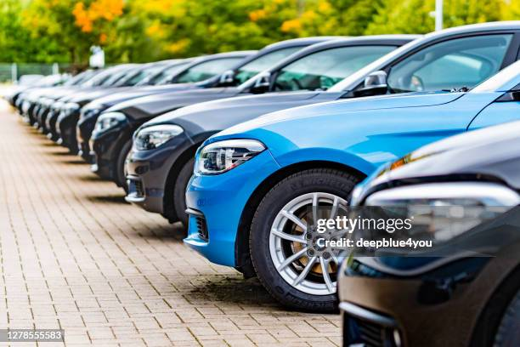
CarLogix : smart sales monitoring system
A powerful key component used in the automobile business:
Car sales Reporting and tracking system

Slide 2

Introduction
In today’s data-driven modern world, standing first in the market competition is everyone’s major goal. In the automotive industry, having a full knowledge of real insights at the right time is necessary. So here is : Carlogix, The Car Sales Tracking and Reporting System, a perfect solution designed to solve this problem. It manages the sales management process for car dealerships and automobile businesses. This project is highly beneficial as it helps us to analyze the data and find the best-selling car in the market and also individual top market leaders based on color, model, public demand, in any particular month or year. Whether you need to analyze sales in the easiest manner or make data-driven decisions to improve the business, this phenomenal system is ready to help!

Slide 3

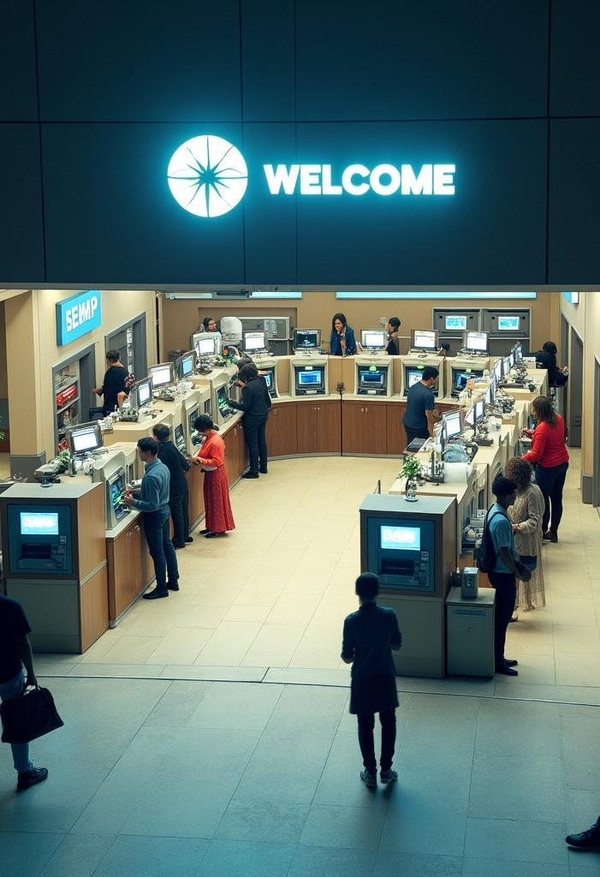
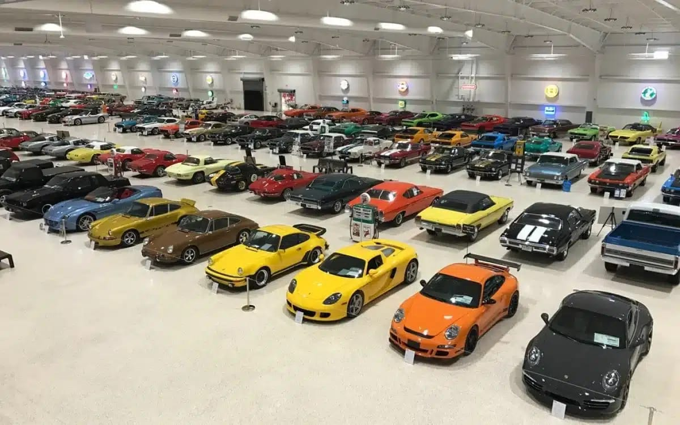
01
Overview

Slide 4

Purpose of Car sales tracking system
The purpose of the Car Sales Tracking and Reporting System is to efficiently manage and monitor monthly car sales across multiple brands.
It is designed to track the data of cars such as total cars sold, best- and least-selling models, and sales filtered by color or model.
By offering real-time insights and detailed reporting, the system enables businesses to analyze trends, optimize inventory, and make data-driven decisions.
Hence it enhances the performance of the business itself and helps in customer targeting, and overall operational efficiency in the automotive industry.

Slide 5
Key Features
The Car sales tracking system includes several key features such as:
Highly secured Password entry for user authentication,
a user-friendly display menu for clear instructions and for the user to input choice and feedback,
efficient sales management and calculation processing that minimizes wait times, ensuring a brilliant experience

Slide 6
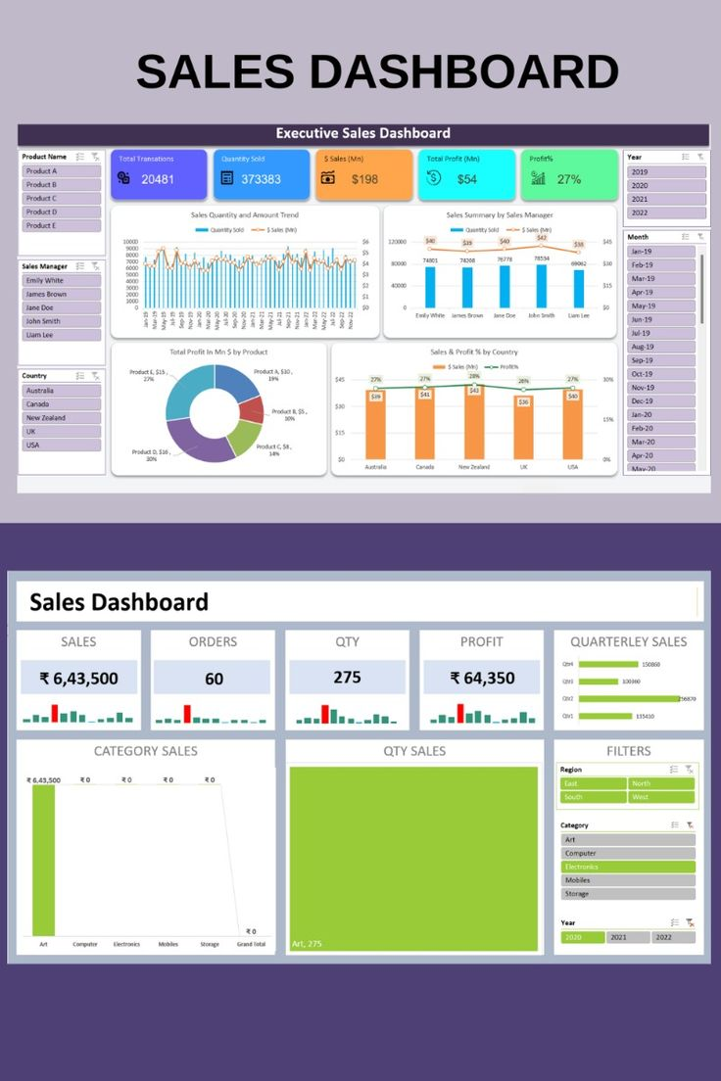

User Interaction

Slide 7

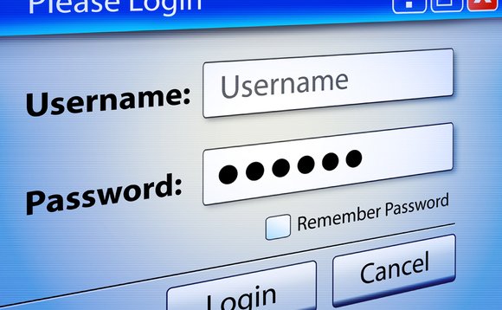
02
Security

Slide 8
Password Authentication
To ensure secure access to the system and protect user accounts, the interface requires the entry of a highly secured password which is same for all users. This multi-factor authentication step verifies that the person using the system is the legitimate account holder, safeguarding against unauthorized access.

Slide 9
03
Operations performed by the Car sales tracking system

Slide 10

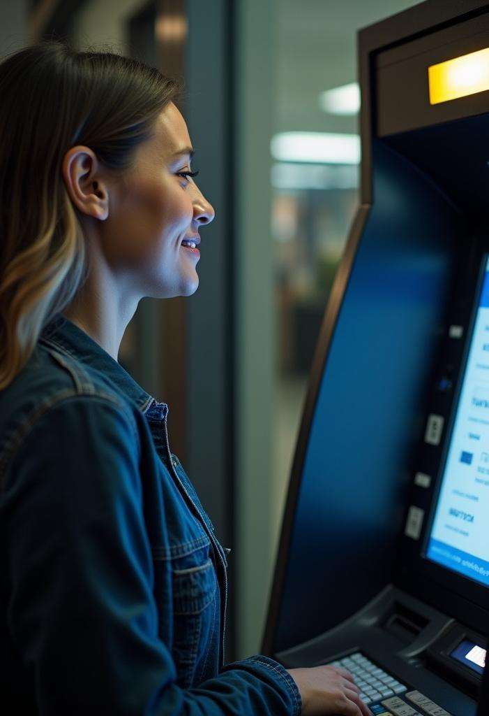
List of operations performed :
Record Monthly Sales Data for multiple car brands (minimum of 3).
Track Total Cars Sold per brand, model, and color.
Identify Best-Selling (Maximum Sales) Cars by brand or model.
Identify Least-Selling (Minimum Sales) Cars by brand or model.
Compare Sales Across Brands or Models.
Respond to On-Demand Queries (e.g., how many red cars were sold).

Slide 11

04
Implementation

Slide 12

Programming with C
The development of the car sales tracking system is done in the C programming language, which is known for its efficiency and performance in handling system-level operations.
This programming choice enables robust handling of input/output operations and ensures reliable interaction with both hardware components and database systems.

Slide 13

Different modules in the system are :
Proposed Modules:
1. Authentication Module: Secure login and user access control.
2. Sales Entry Module: Input and manage car sales data and customer's personal details like name address.
3. Reporting Module: Generate sales reports based on brand, model, and date of purchase, price, number.
4. Inventory Management Module: Track available stock and sold vehicles and have an overall comparison regarding the same.

Slide 14
Conclusions
The Car Sales Tracking and Reporting system empowers businesses to operate more efficiently. It has a wonderful ability to manage multi-brand sales and generate meaningful reports, it plays a crucial role in driving overall sales performance.

Slide 15
Thank you!
-by Mehak Sethi

